Slide 1
Operating Systems
7. Memory Management
1

Slide 2
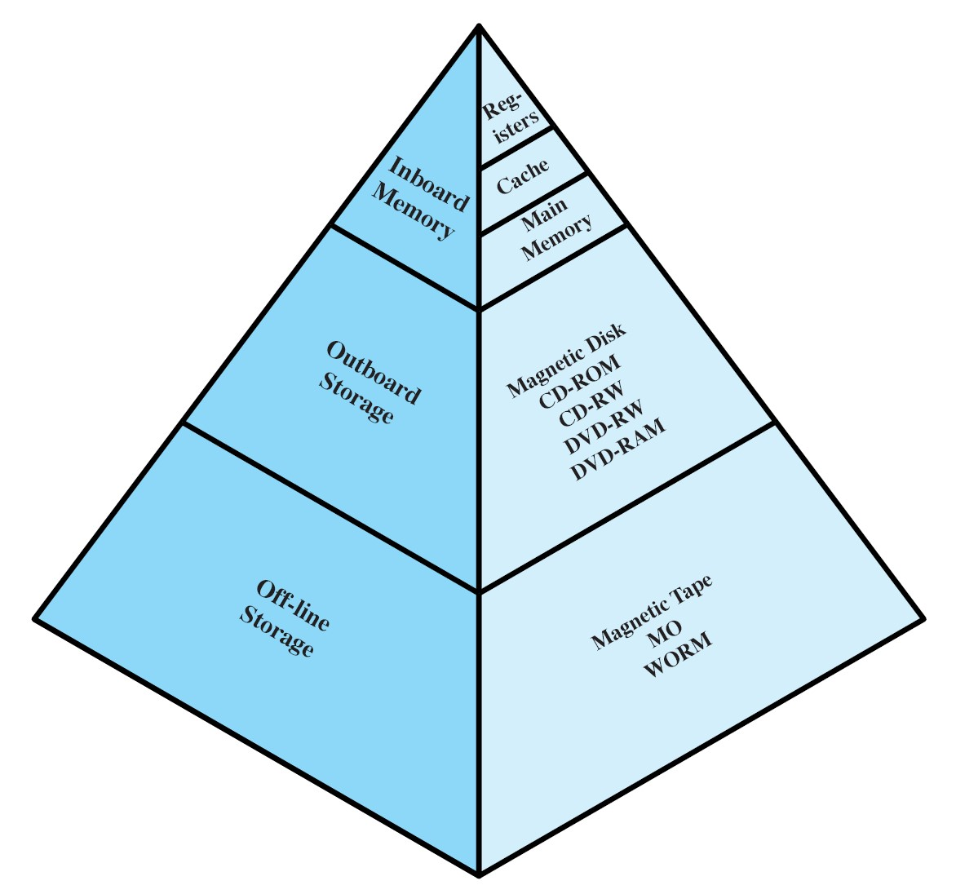
Memory Management
Ideally programmers want memory that is
Large
Fast
Non volatile
Memory hierarchy
Small amount of fast, expensive memory – cache
Some medium-speed, medium price main memory
Gigabytes of slow, cheap disk storage
Memory manager handles the memory hierarchy

Slide 3
Requirements for Memory Management Unit (MMU)
Relocation
Change the physical placement of a process
Protection
Restrict processes access to physical memory
Sharing
Allow processes to share memory location
Logical Organization
Support organization of computer programs etc.
Physical Organization
Efficient utilization of hardware
Memory hierarchy

Slide 4
Background
Program
Typically resides on disk
Must be brought into memory to be executed
Address binding of a program
Compile time
Program must always be loaded to the same memory location
Load time
Memory location determined when program is loaded
Run time/ Execution time
No absolute memory locations
Memory location determined by memory management unit (MMU)
Swapping of processes and relocation

Slide 5
Background
Memory
Can be subdivided to accommodate multiple processes
Needs to be allocated efficiently to pack as many processes into memory as possible

Slide 6
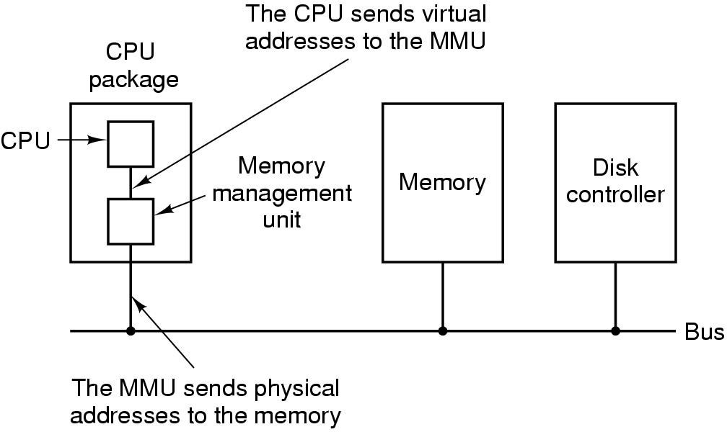
Position and Function of the MMU
Logical address: Generated by the CPU
Also referred to as virtual address or relative address
Physical address: Address seen by the memory unit
Also referred to as absolute address

Slide 7
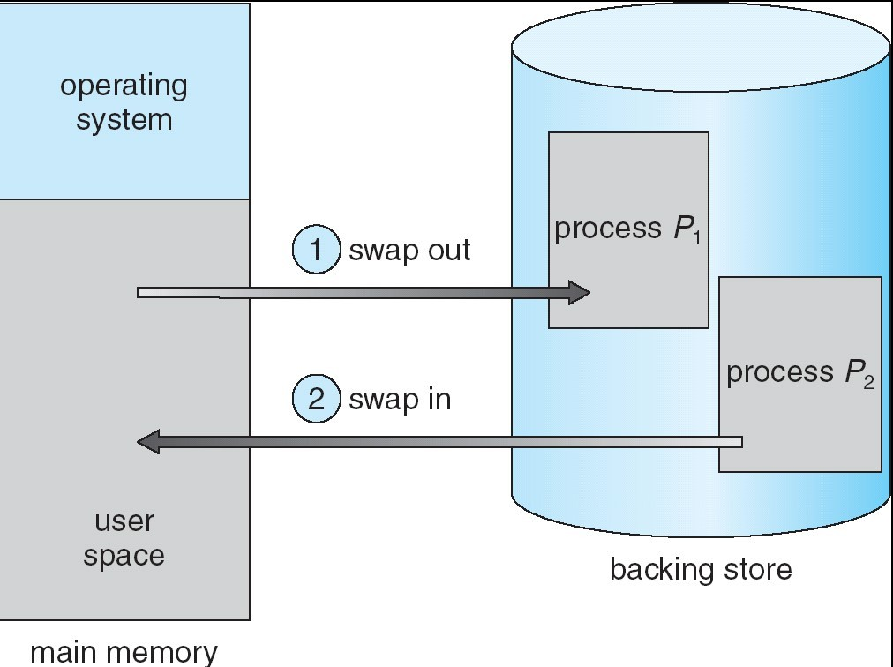
Sharing Memory Through Swapping
A process can be swapped out of memory to a backing store
– Swap device
Later brought back (swap-in) into memory for continued execution

Slide 8
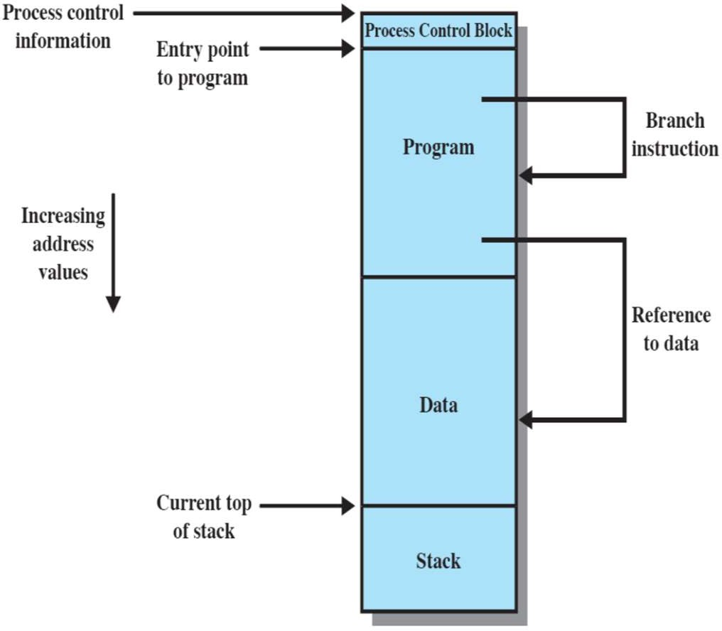
Relocation and Protection
Relocation
Swapping
Program must be relocated
Cannot be sure about the location in memory
Addressing
No absolute addressing feasible
For example, locations of variables, code routines
Protection
Must keep a program out of other processes’ partitions

Slide 9
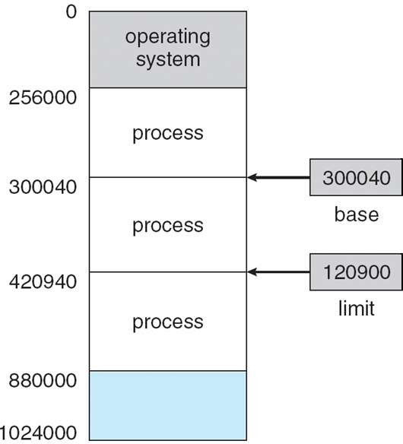
Hardware Support For Relocation and Protection
Base, bounds (limit) registers
Define the range which a process can access
Set when the process is executing

Slide 10
Hardware Support For Relocation and Protection
Addition and comparison has to be performed on every address
Absolute Address
Physical Address
Interrupt
800K
Partition 4
700K
Limit Register
Comparator
Partition 3
400K
Partition 2
Base Register
Adder
200K
Partition 1 Operating
Memory Management Unit (MMU)
100K
0
Logical Address
System
Relative Address

Slide 11
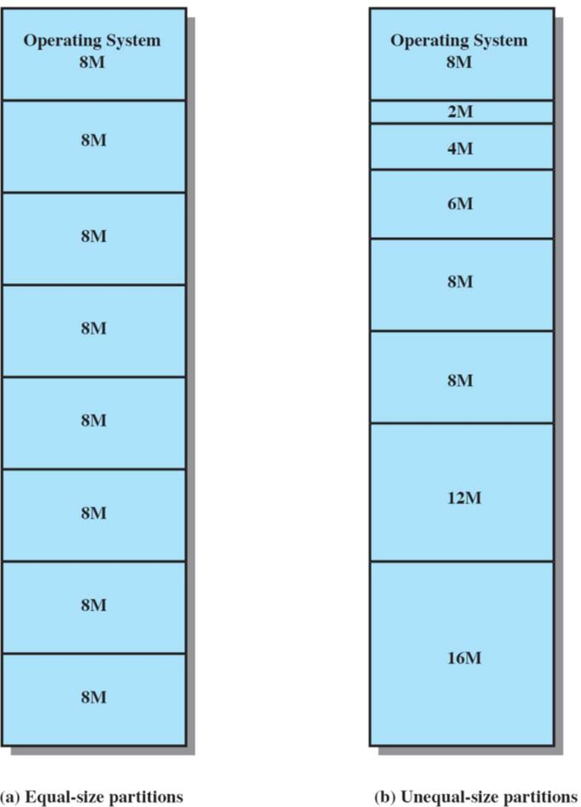
Contiguous Allocation of Memory: Fixed Partitioning
Any program, no matter how small, occupies an entire partition
Causes internal fragmentation
Allocated memory can be larger than requested memory
Difference internal to a partition, but not being used by the process

Slide 12
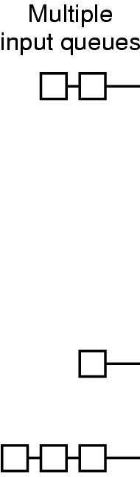
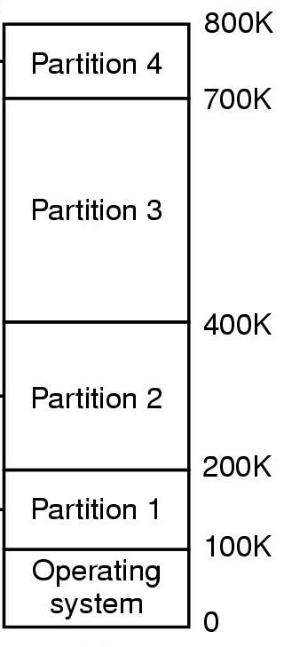
Fixed Partitioning
Multiple Queues
Small processes have to wait, even though plenty of memory is free
When a large partition is empty
Queues for small partition is full
Alternative: Maintain a single Queue

Slide 13
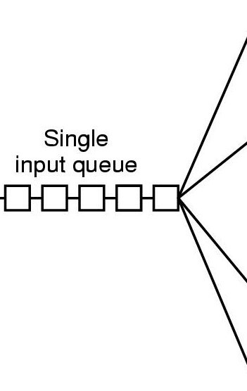
Fixed Partitioning
Single Queue
Whenever a partition becomes free, a process is selected
Closest to the front of the queue
Smaller than the partition size
Undesirable to waste a large partition for smaller process
Search the queue, find the largest process that fits it
Unfair for smaller processes
A process may not be skipped more than k times
800K
Partition 4
700K
Partition 3
400K
Partition 2
200K
Partition 1 Operating
100K
System
0

Slide 14
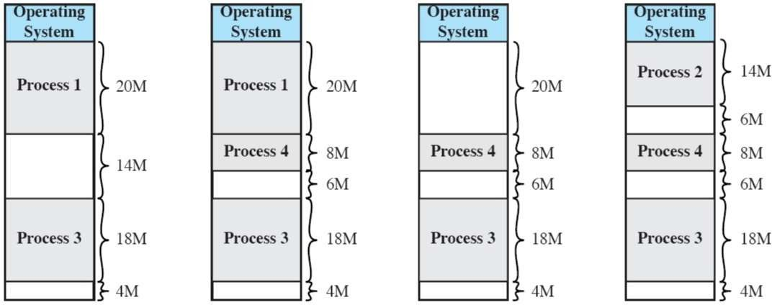
Contiguous Allocation: Dynamic Partitioning
Process is allocated exactly as much memory as required
Eventually holes in memory: External fragmentation
Total memory space exists to satisfy a request
But it is not contiguous
Must use compaction to shift processes (defragmentation)

Slide 15
Memory Management With Bitmaps
Memory is divided up into allocation units
Few words
Or several kilobytes
A.
. . .
B
C
D
E
8
16
24
1 | 1 | 1 | 1 | 1 | 0 | 0 | 0
1 | 1 | 1 | 1 | 1 | 1 | 1 | 1
1 | 1 | 0 | 0 | 1 | 1 | 1 | 1
1 | 1 | 1 | 1 | 1 | 0 | 0 | 0
0
0
0
0
0
0
0
0
0
0
0
0
0
0
0
0
0
0
0
0
0
0
0
0
... … …

Slide 16
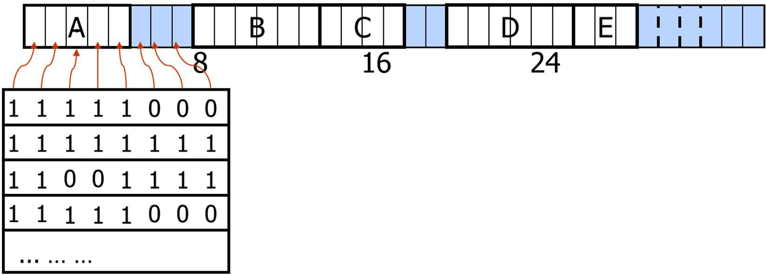
Memory Management With Bitmaps
Size of allocation unit is important
Smaller allocation unit
Larger bitmap required
Larger allocation unit
Smaller bitmap required
More memory will be wasted
If the process size is not an exact multiple of the allocation unit

Slide 17
Memory Management With Bitmaps
To bring a k unit process in memory
Search for a k run consecutive 0 bits in the map
Search can be slow
Since, k run may cross word boundaries
1 | 1 | 1 | 1 | 1 | 0 | 0 | 0
1 | 1 | 1 | 1 | 1 | 1 | 0 | 0
0 | 0 | 1 | 1 | 1 | 1 | 1 | 1
1 | 1 | 1 | 1 | 1 | 0 | 0 | 0
Find run of length = 3
Find run of length = 4
0
0
0
0
0
0
0
0
0
0
0
0
0
0
0
0
0
0
0
0
0
0
... … …

Slide 18
Memory Management with Linked Lists
Linked list of memory segments
Free segments → Holes
Allocated segments → Processes
A.
. . .
B C D 16
H 5 3 P 8 6
E
8
24
P 0
₅ .
P 14
₄ .
H 18 2
P 20 6
P 26 3

Slide 19
Memory Management with Linked Lists
Segment list is sorted by addresses
Sorting helps in updating the list, when a process is swapped out or exits
A process usually has two neighbors
Updating the list requires
A
X
B
➔
A
. . .
B
Replace P by H
. . .
A
X
➔
➔
A
. . .
Two entries are merged
. . .
X
B
. . .
B
Two entries are merged
. . .
X
➔
. . .
Three entries are merged
. . .

Slide 20
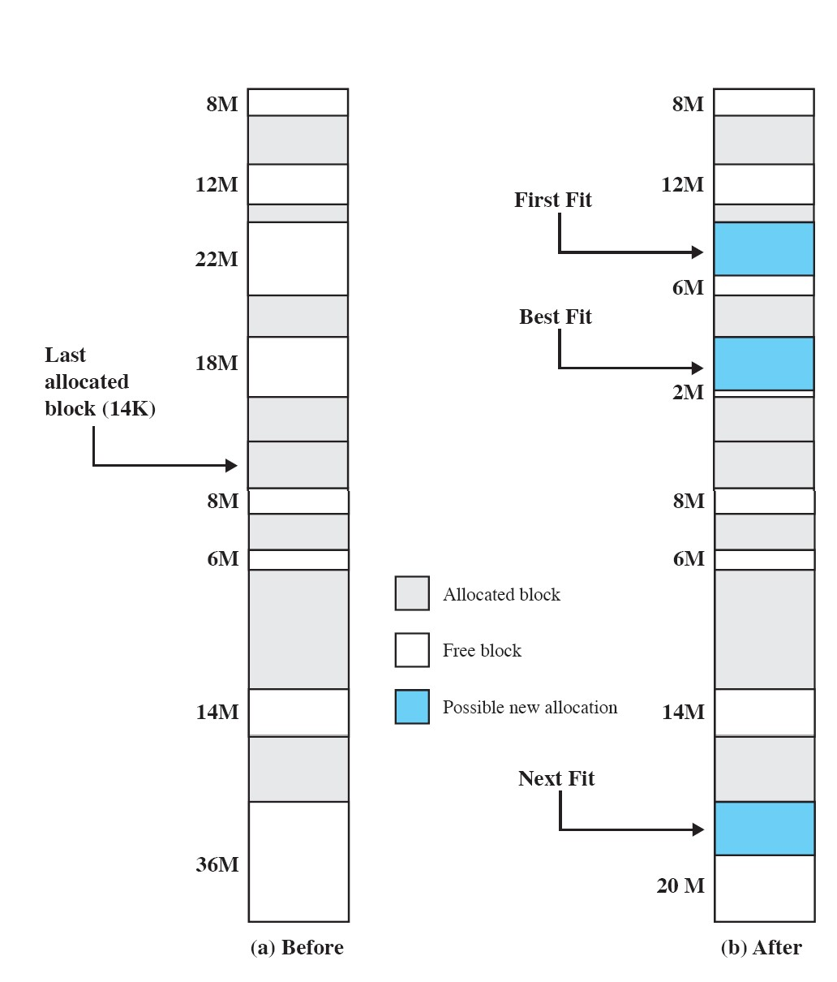
Dynamic Partitioning: Placement Algorithms
First-fit: Use the first block that is big enough
– Simple and fast

Slide 21
Dynamic Partitioning: Placement Algorithms
Next-fit: Use the next block that is big enough
Tends to eat-up the large block at the end of the memory
Gives no better performance than First-fit

Slide 22
Dynamic Partitioning: Placement Algorithms
Best-fit: Use the smallest block that is big enough
Must search entire list (unless free blocks are ordered by size)
Produces the smallest leftover hole
Tends to fill up memory, with tiny useless holes
First Fit generates larger holes on the average

Slide 23
Dynamic Partitioning: Placement Algorithms
Worst-fit: Use the largest block
Must also search entire list
Produces the largest leftover hole…
… but eats-up big blocks

Slide 24
Memory Management with Linked Lists
Search time of all four placement algorithms can be improved by
Keeping separate lists for Process and Holes
While allocating memory only have to search the lists of holes
The Hole list can be kept sorted by size
As soon as a hole that fits is found, no more searching is required
Drawback
Problem while de-allocating memory
A node from the process list has to be inserted in the hole list

Slide 25
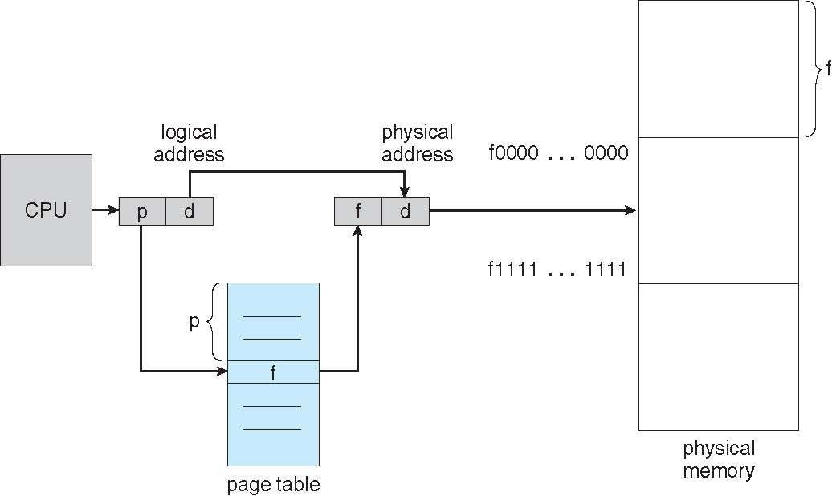
To Avoid External Fragmentation: Paging
Partition memory into small equal-size chunks (frames)
Divide each process into the same size chunks (pages)
OS maintains a page table for each process
Contains the frame location for each page in the process
Memory address = (page number, offset within page)

Slide 26
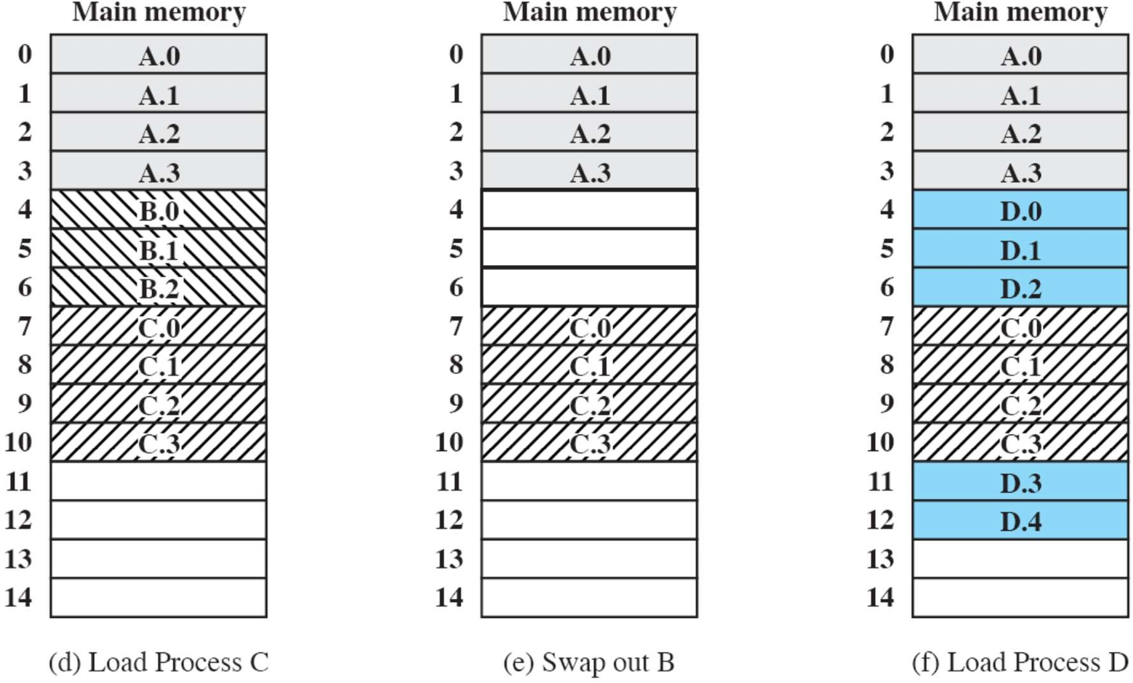
Page Example: Allocation of Frames

Slide 27
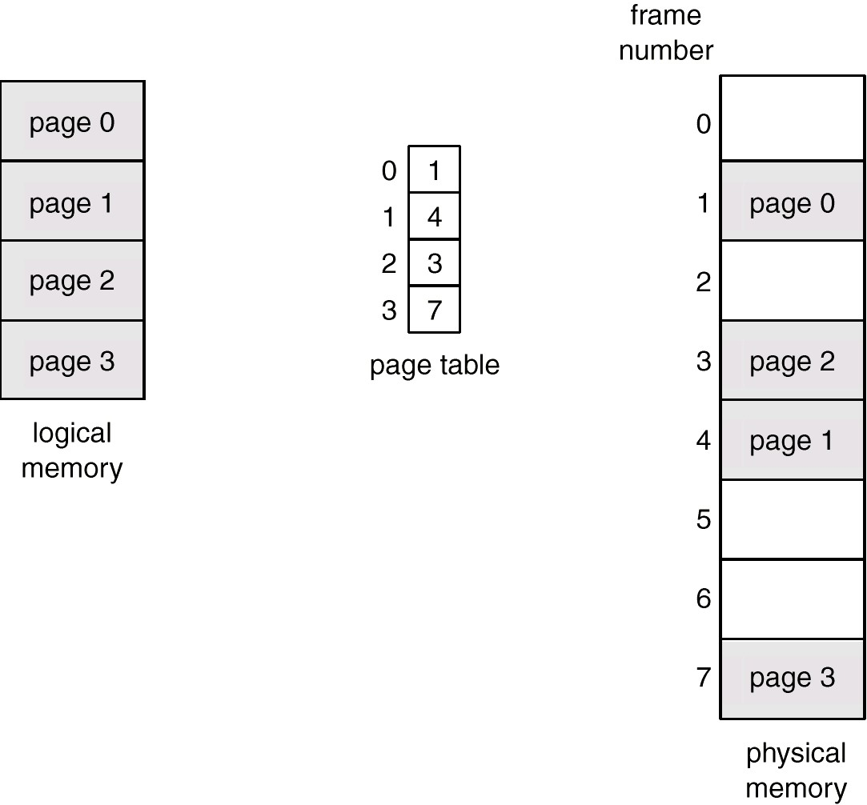
Paging Example
Pages of a process form the logical memory
Maintain for each process a page table
Question: Do we avoid fragmentation completely?

Slide 28
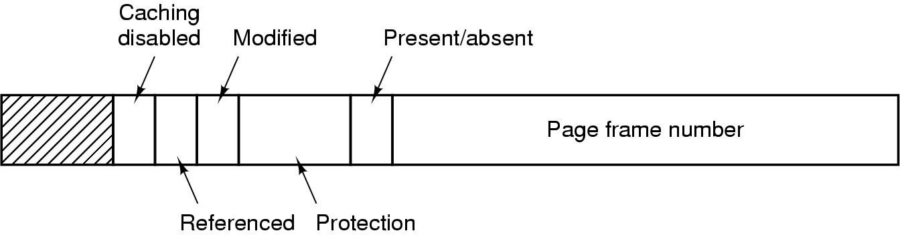
Typical Page Table Entry
Exact layout is hardware dependent
Present/Valid: value valid to be used, otherwise page fault
Protection: defines accesses which are permitted
Referenced: help to decide which frames can be reclaimed
Caching: Needed if value is read from I/O device
Modified: Needed if page frames are reclaimed
– Dirty: Needs to be written to disk first

Slide 29
Paging Example
P2 0 X 2 X X X
P3
4
X 7 X
20k-24k
16k-20k
12k-16k
8k –12k 4k – 8k 0k – 4k
1
0
1
0
0
0
12k-16k
8k –12k 4k – 8k 0k – 4k
1
0
1
0
Present bit
Physical Address Space (RAM)
0k – 4k 4k – 8k 8k –12k 12k-16k
14k-20k
20k-24k
24k-28k
0
1
2
3
4
5
6
7
P1 3 X 1
6
16k-20k
12k-16k
8k –12k 4k – 8k 0k – 4k
1
0
1
1
5 1
28k-32k
7-Memory
29

Slide 30
Address Translation Scheme
Address generated by CPU is divided into two parts
Page number (p) – used as an index into a page table which contains base address of each page in physical memory
Page offset (d) – combined with base address to define the physical memory address that is sent to the memory unit
page number
p m - n
page offset
d n
For given logical address space 2^{m} and page size 2^{n}

Slide 31
Address Translation Scheme
Size of logical address space = 2^{m}
# of pages (2^{m-n})× page size (2^{n})
Example: 16 X 4096
2^{m} = 2⁴ X 2¹²
2^{m} = 2¹⁶
m = 16 bits
page number
p m - n
page offset
d n

Slide 32
Address Translation Scheme: Example
Given m=16 and n=12
Page number = m-n bits = Leftmost 4 bits
– 4 bit page number can represent 16 pages
Page offset = n bits = Rightmost 12 bits
12 bit offset can address all 4096 bytes within a page (Frame size) !!
Consider logical address 8196 = 0010000000000100
– Page number is 2 and offset is 4
page number
p m - n
page offset
d n

Slide 33
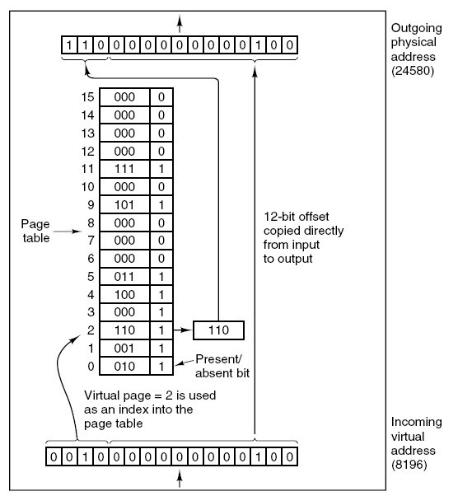
Address Translation Scheme: Example

Slide 34
Address Translation Scheme: Example
Consider an address of m = 16 and n = 10 bits
Leftmost m-n bits are page number
Rightmost n bits are the offset
Given a logical address 0000010111011110
Page number is 1 and offset 478
Suppose this page is residing in main memory frame 6 (000110)
Physical address is frame number 6, offset 478
page number
p m - n
page offset
d n

Slide 35
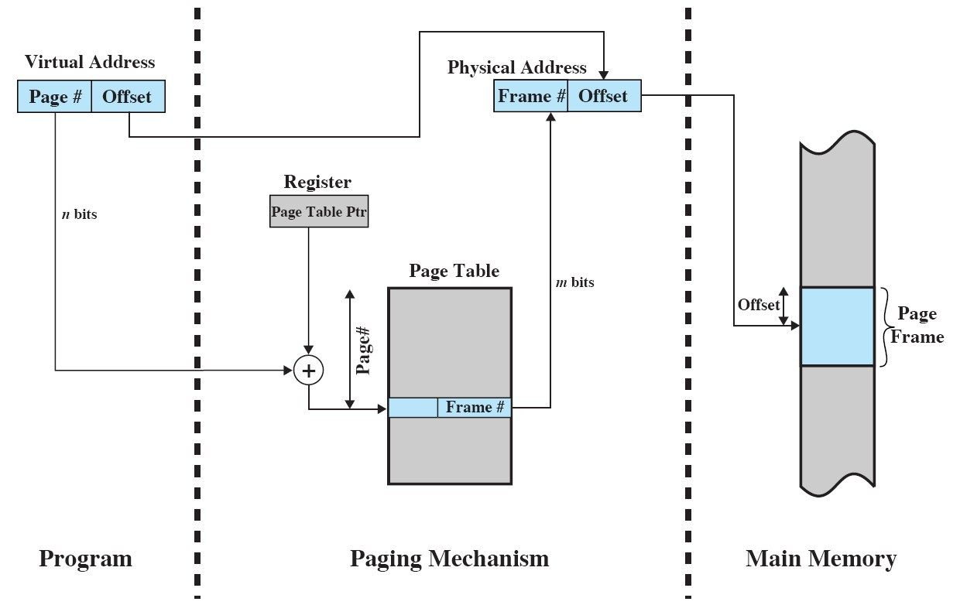
Implementation of Page Table – Main Memory
Page table is kept in main memory
Page-table base register (PTBR) points to the page table
Page-table length register (PRLR) indicates size of the page table
Each program reference to memory → 2 memory accesses

Slide 36
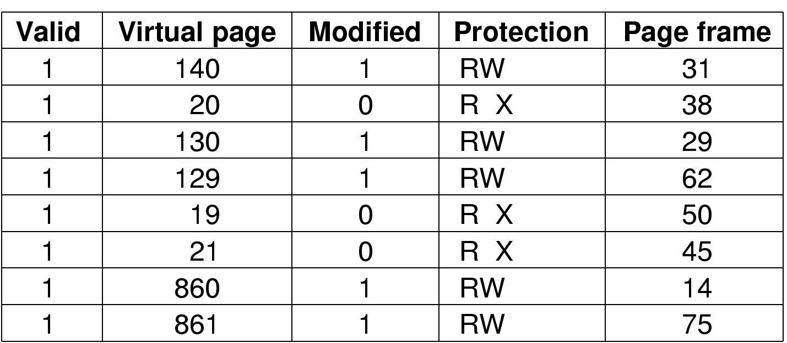
Implementation of Page Table – Associative Memory
Translation Lookaside Buffers (TLBs)
Special fast-lookup hardware cache
Parallel search (cache for page table)
Resides usually inside the MMU
Address translation (P, O)
If P is in associative register (hit)
Get frame # from TLB
Else get frame # from page table in m

Slide 37
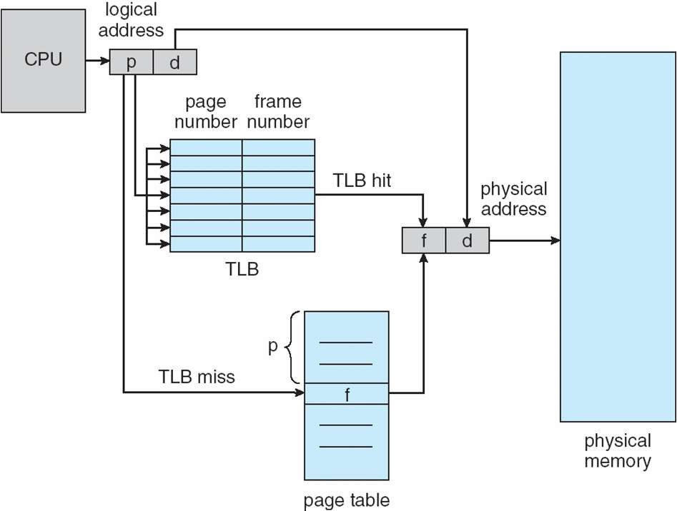
Paging Hardware With TLB

Slide 38
Access Time With Cache Registers
Associative Lookup = s time units (fraction of microsecond)
Can be < 10% of memory access time
Hit ratio (= α)
Percentage of times a page number is found in associative registers
Effective Access Time = (1 + s) α + (2 + s)(1 – α) = 2 + s – α
Assume memory cycle time is 1 microsecond
Example:
Consider α = 80%, s = 20ns for TLB search, 100ns for memory access
Effective access time = 0.80 * 120 + 0.20 * 220 = 140 ns

Slide 39
Single-Level Page Table Limitation
Consider a system with
32-bit logical address space
4KB frame size
How many entries will be in the (single-level) page table?
2²⁰ (1 million) entries
Each entry of page table consists of 4 bytes
What will be the size of (single-level) page table?
4MB
page number
p m - n
page offset
d n

Slide 40
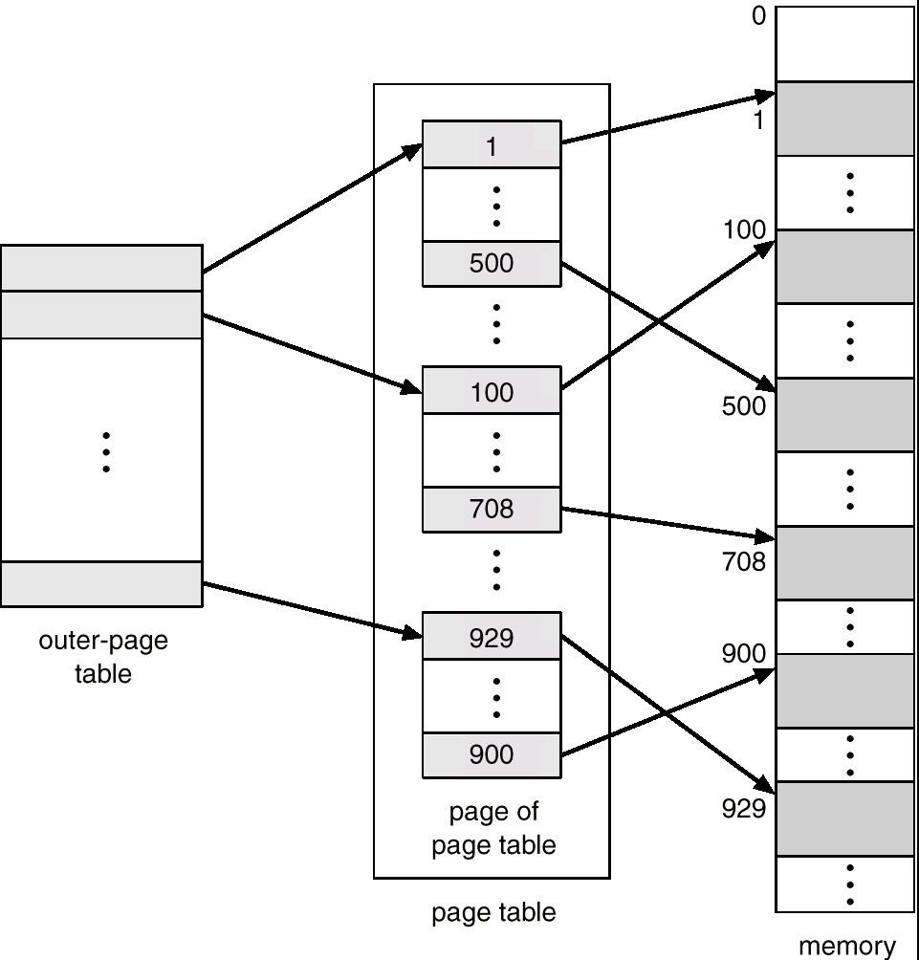
Two-Level Page-Table Scheme
Page-table may be large, i.e., occupy several pages/frames itself

Slide 41
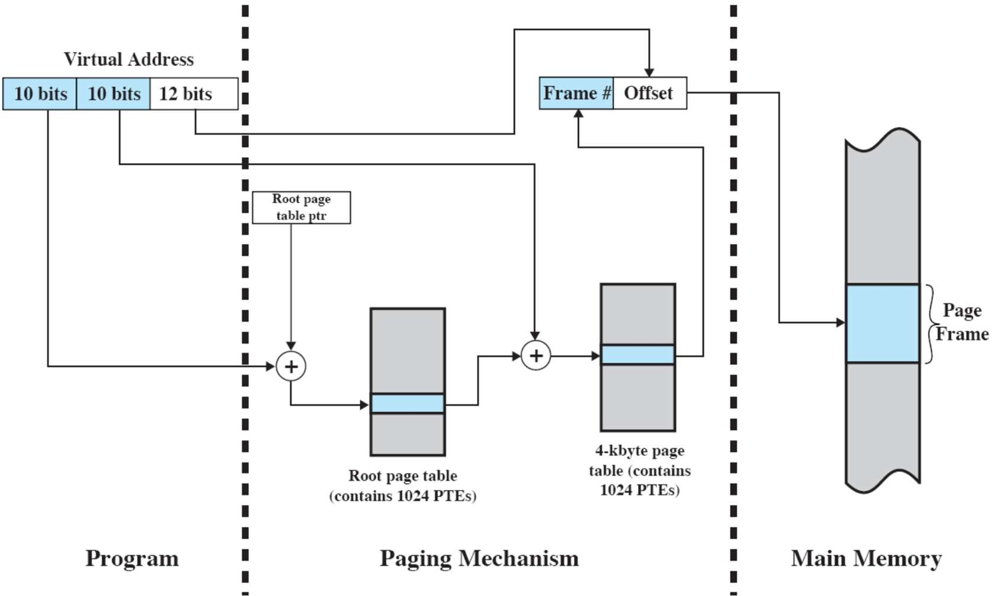
Address Translation in Two-Level Memory
Assume byte level addressing
– 2³² bytes = 2²²kbytes = 2¹²Mbytes = 4Gbytes can be supported
2¹⁰ page frames can be addressed

Slide 42
Multi-Level Page Table
Even two-level paging scheme might not be sufficient
Consider a system with 64-bit logical address space
Frame size is 4 KB (2¹²)
How many entries in single-level page table?
Page table has 2⁵² entries
How many entries in two-level page table
outer page inner page page offset
p₁
42
p₂
10
d
12

Slide 43
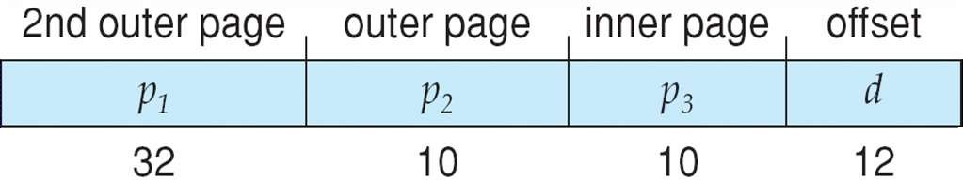
Multi-Level Page Table
How many entries in three level page table?
How many levels are require such that each page table fits within a single frame?

Slide 44
Inverted Page Table
One entry for each page frame of real memory
Entry consists of
Virtual address of the page stored in that real memory location,
With information about the process that owns that page
Decreases memory needed to store each page table
But increase in time needed to search the table when a page reference occurs
Use hash table to limit the search to one — or at most a few — page-table entries

Slide 45
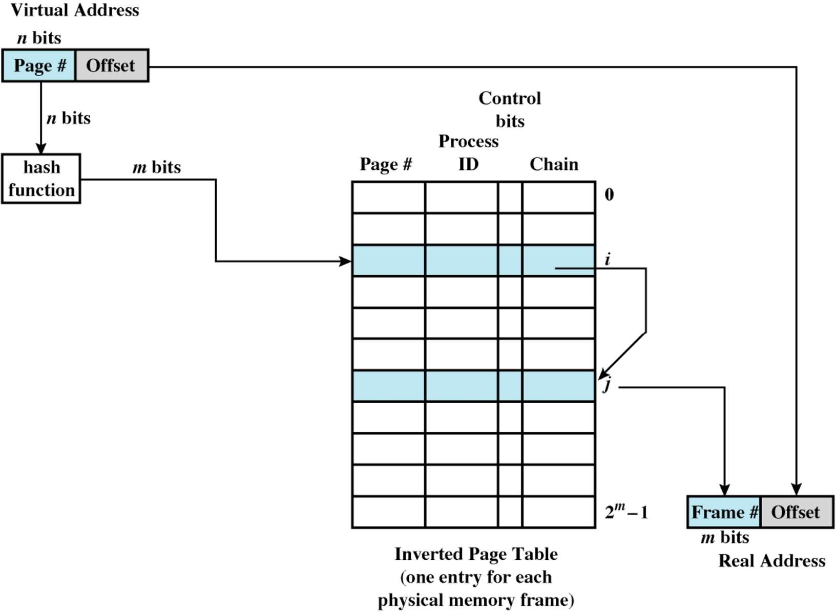
Inverted Page Table Example

Slide 46
Chapter Overview
Background
Memory allocation schemes
Fixed partition
Dynamic partition
Paging
Virtual memory

Slide 47
Execution of a Program: Virtual Memory Concept
Main memory = cache of the disk space
Operating system brings into main memory a few pieces of the program
Resident set - portion of process that is in main memory
Whenever an address is needed that is not in main memory
Generation of a page-fault interrupt
OS places the process in blocking state and issues a disk IO request
Another process is dispatched

Slide 48
Valid-Invalid (Present/Absent) Bit
With each page table entry a valid–invalid bit is associated
– 1 → in-memory
– 0 → not-in-memory (Initially 0)
Frame #
valid-invalid bit
1
1
1
1
0

0
0
Page table
During address translation, if valid-invalid bit in page table entry is 0
– Page fault interrupt to OS

Slide 49
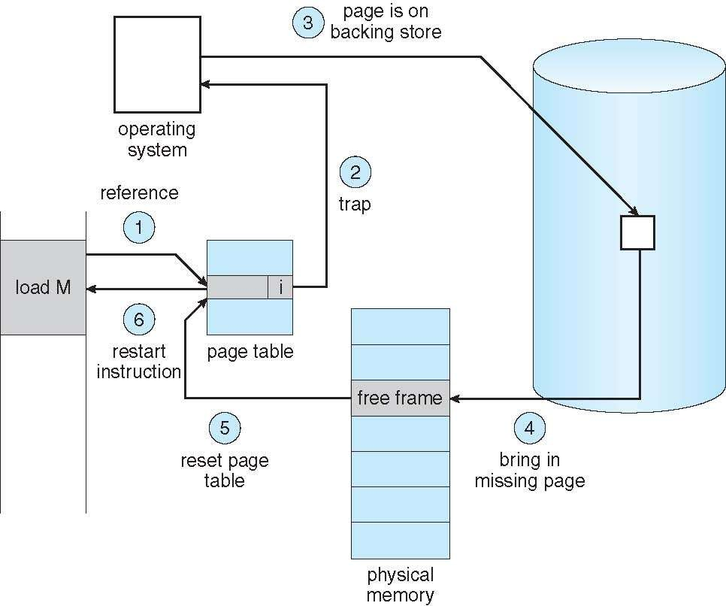
Page Fault and Address Translation
In response to page-fault, paging hardware issue trap to OS
Check validity of memory reference
Get empty frame (swap out that page?)
Swap in page into frame
Reset tables, validation bit
Restart instruction
7-Memory 49

Slide 50
If There is No Free Frame?
Page replacement
Goal: Algorithm which will result in minimum number of page faults
Page fault forces choice
Which page must be removed
Make room for incoming page
Modified page must first be saved
Unmodified just overwritten (use dirty bit to optimize writes to disk)
Better not to choose an often used page
Will probably need to be brought back in soon

Slide 51
First-In-First-Out (FIFO) Replacement Algorithm
Can be implemented using a circular buffer
Example: Reference string: 1, 2, 3, 4, 1, 2, 5, 1, 2, 3, 4, 5
– 3 frames
1 4 5
1 3 9 page faults
2 4
– 4 frames
1
2
3
4
5 4
1 5 10 page faults
2
3
Belady’s Anomaly: More frames, sometimes more page faults
– Problem: replaces pages that will be needed soon

Slide 52
Optimal Replacement Algorithm
Replace page that will not be used for longest period of time
4 frames example
– 1, 2, 3, 4, 1, 2, 5, 1, 2, 3, 4, 5
1 | 4
2 |  | 6 page faults
3
4 | 5
How can we know this information?
Standard for measuring how well other algorithms perform

Slide 53
Least Recently Used (LRU) Replacement Algorithm
Idea: Replace the page that has not been referenced for the longest time
By the principle of locality, this should be the page least likely to be referenced in the near future
Implementation
Tag each page with the time of last reference
Use a stack
Problem
High overhead
OS kernel involvement at every memory reference!!!
If hardware support not available

Slide 54
LRU Algorithm
4 frame example
– 1, 2, 3, 4, 1, 2, 5, 1, 2, 3, 4, 5
1
2
3
4
5
8 page faults
5 4
3

Slide 55
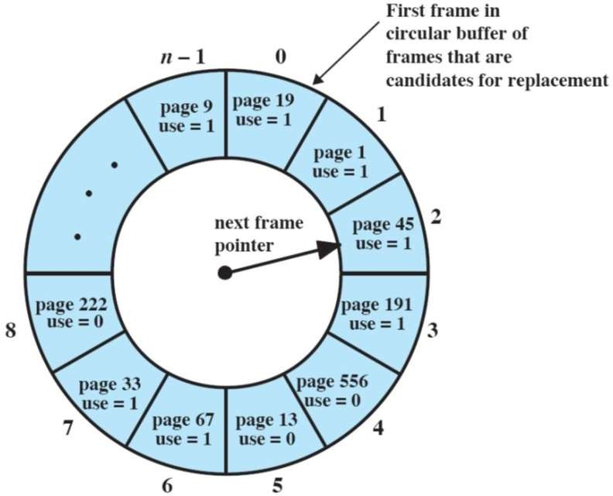
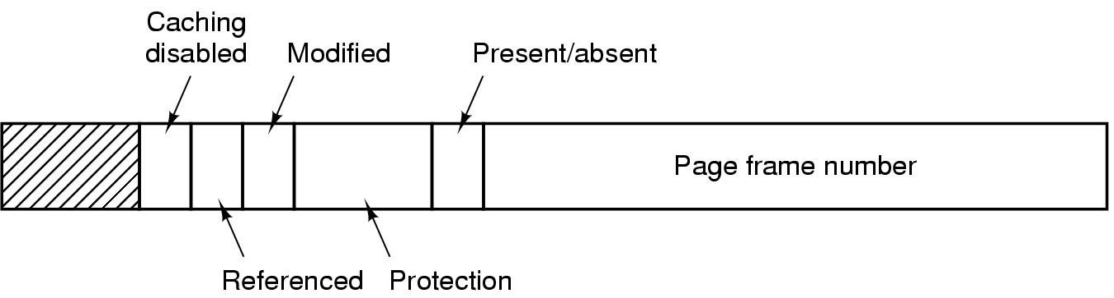
LRU Approximations: Clock/Second Chance
Uses reference (use) bit
Initially 0
When page is referenced, set to 1 by HW
To replace a page
The first frame encountered with use bit 0 is replaced
During the search for replacement, each use bit set to 1 is changed to 0 by OS
Note: if all bits set → FIFO

Slide 56
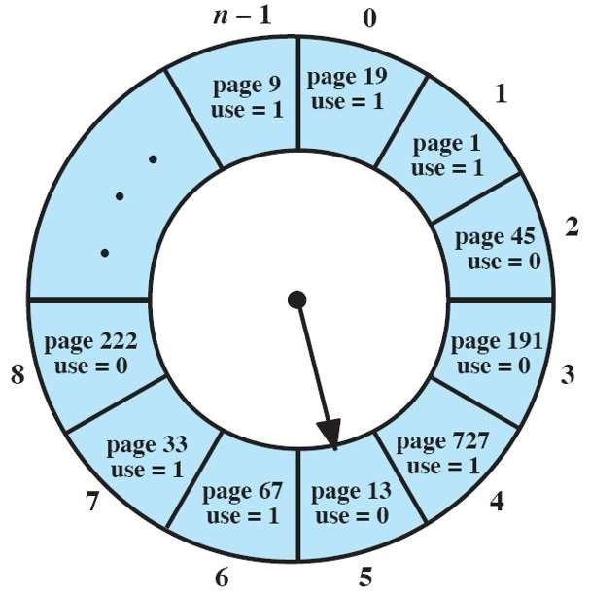
Example Clock Policy

Slide 57
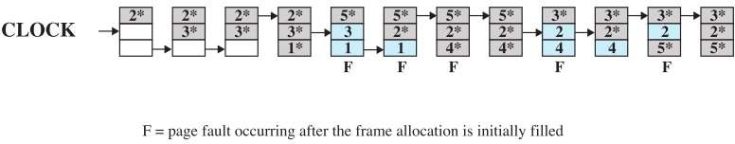
Example Clock Policy

Slide 58
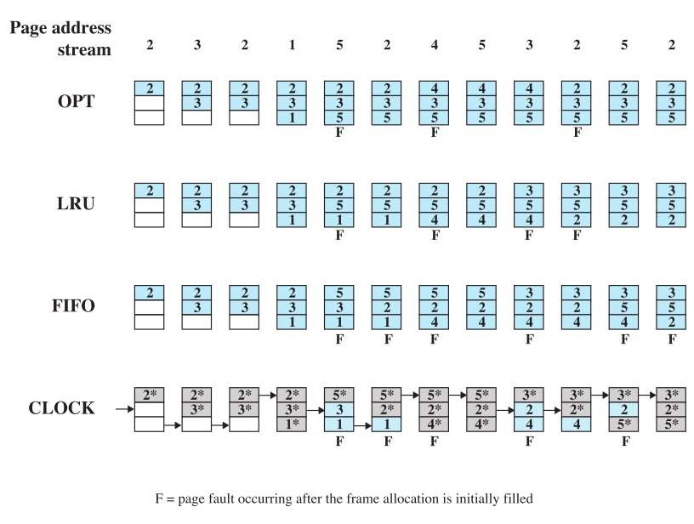
Comparison of Basic Replacement Algorithms

Slide 59
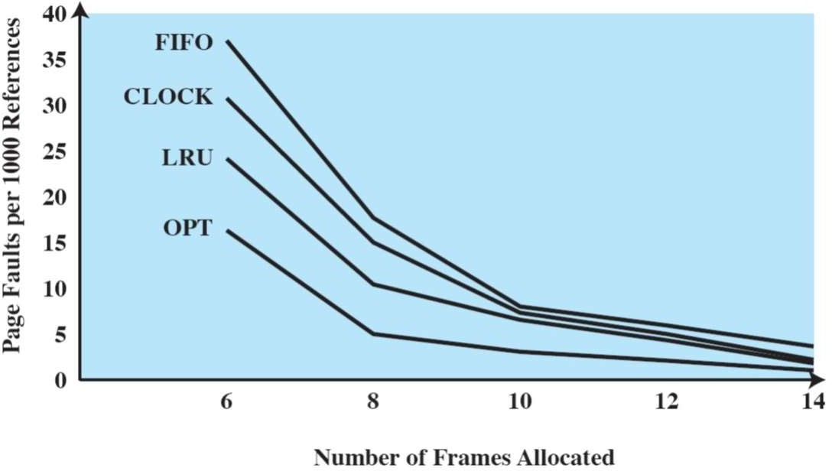
Comparison of Basic Replacement Algorithms

Slide 60
Enhancement of Clock/Second Chance
Clock algorithm can be made more powerful by using more bits
Use reference bit (R) and modify bit (M) as an ordered pair
With R and M bits, the following four classes are possible
Class 0: Neither recently used nor modified (R=0, M=0)
Best page to replace
Class 1: Not recently used but modified (R=0, M=1)
The page will need to be written out before replacement
Class 2: Recently used but clean (R=1, M=0)
Probably page will be used again soon
Class 3: Recently used and modified (R=1, M=1)
Probably page will be need soon and disk I/O is required to write page
Replacement strategy
Replace the first page encountered in the lowest non empty class

Slide 61
Enhancement of Clock/Second Chance
When a process starts
All its page entries are marked as not referenced and not modified
When a page is referenced
The R (reference) bit is set
When the page is later written to
The M (modified) bit is set
Difference to clock algorithm
Preference are given to pages that have been modified to reduce I/O

Slide 62

Any Question So Far?

